Slide 1
Training Reinforcement Learning Models
B!gThinkAI x BitCamp Workshop 1

Slide 2
What is BigThinkAI
Campus club dedicated to making easily accessible AI workshops and projects for students interested in learning basics to advanced level ML concepts
Pyoneer meetings - Very similar to this workshop! Underlying concepts to real-life example

Slide 3
Goals
Main motive: teach an LLM to reason better using RL
Understand how to prepare a dataset for RL
Learn how to write reward functions to guide model learning
Use Unsloth and TRL (Transformers Reinforcement Learning) to fine-tune a large learning model

Slide 4
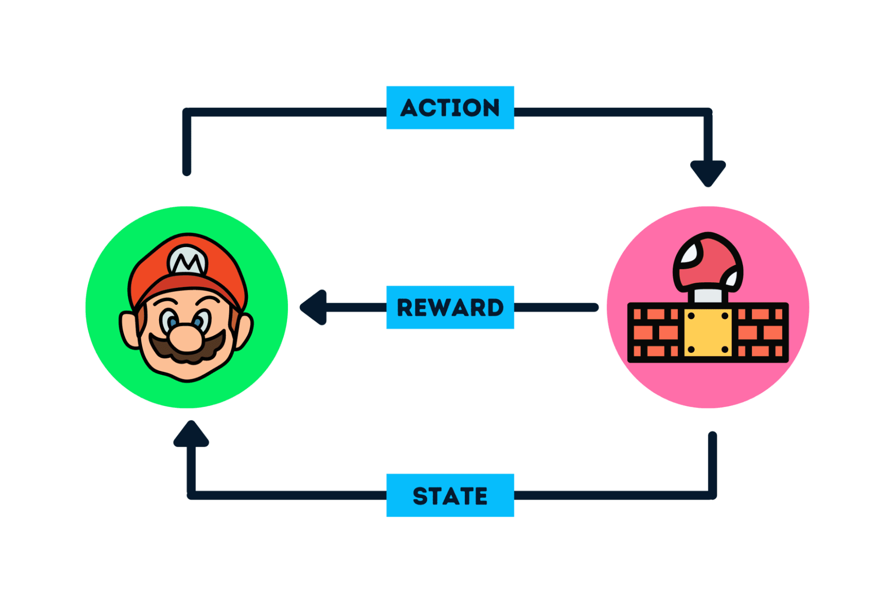
Reinforcement Learning - High Level
Machine Learning in a dynamic environment that gets rewarded for good decisions
Key Components:
Agent - the thing that is “learning”
Action - decisions made by agent
Policy - how an agent maps state to action
Environment - the “world” in which the agent acts
Reward Signal - Feedback from environment and how our agent did

Slide 5
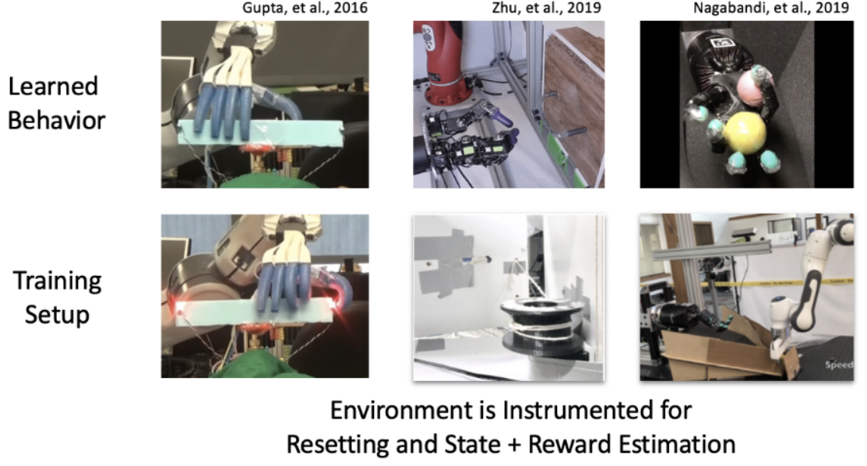
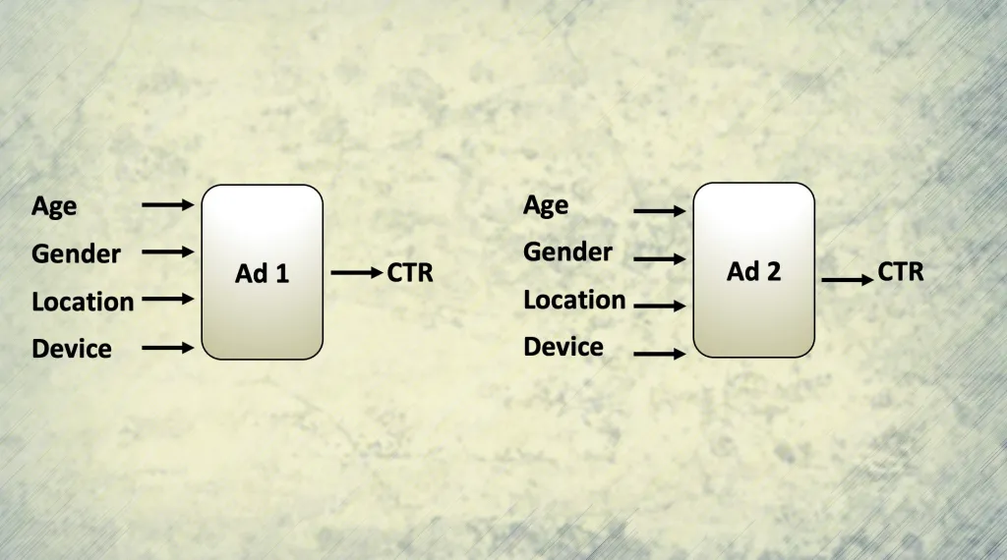
Robotics Movement and Automation
Advertisement Algorithms

Slide 6
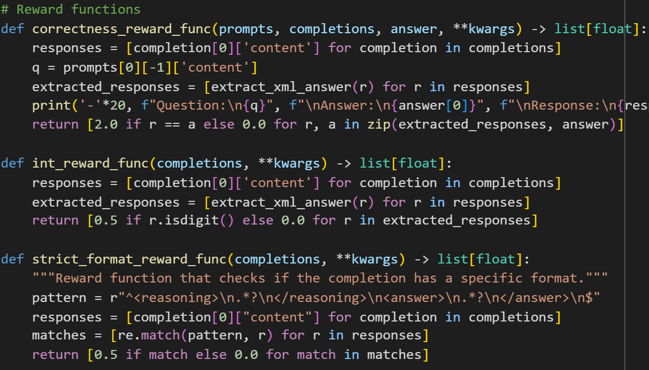
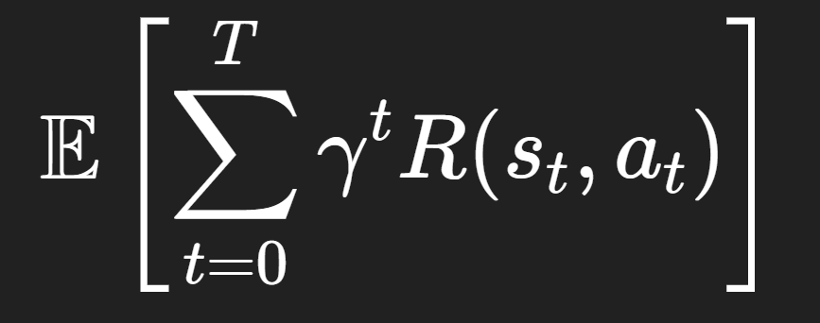
Reward Functions
The core of Reinforcement Learning!
How we reward the mode for good decisions

Slide 7
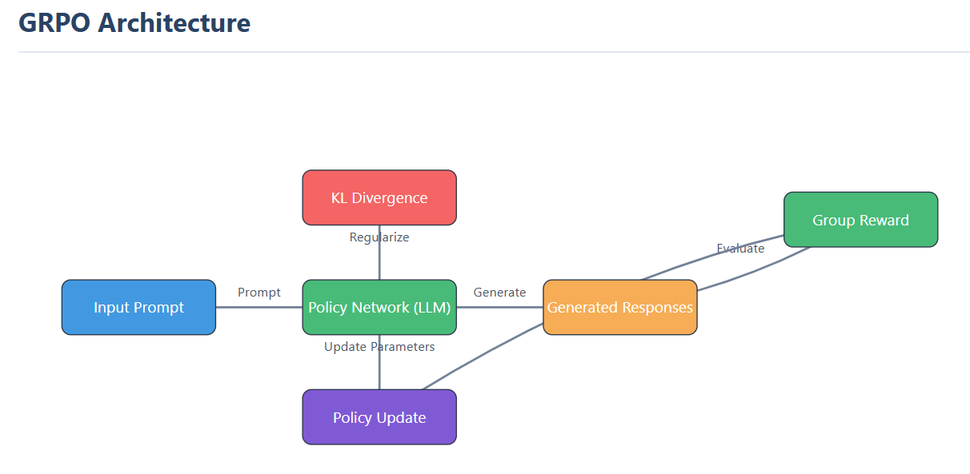
Penalizing model for getting off track
Adjusting the model’s parameters

Slide 8
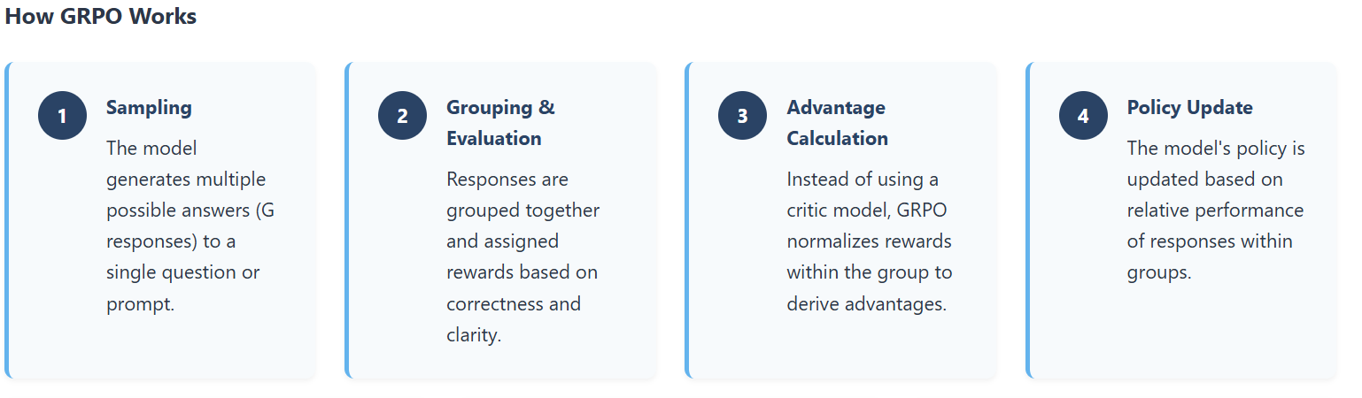
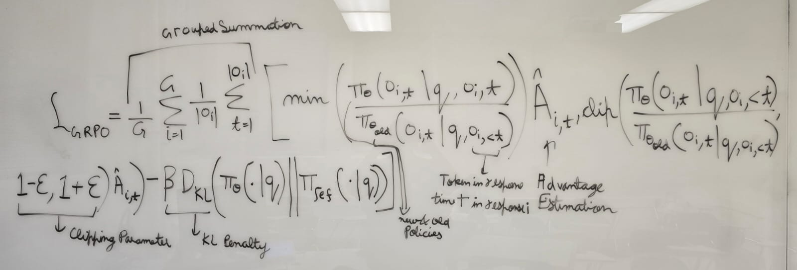

Slide 9
Resources
https://bdtechtalks.com/2021/02/22/reinforcement-learning-ad-optimization/
https://bair.berkeley.edu/blog/2020/04/27/ingredients/
https://ghost.oxen.ai/why-grpo-is-important-and-how-it-works/
https://aws.amazon.com/what-is/reinforcement-learning/

Slide 10
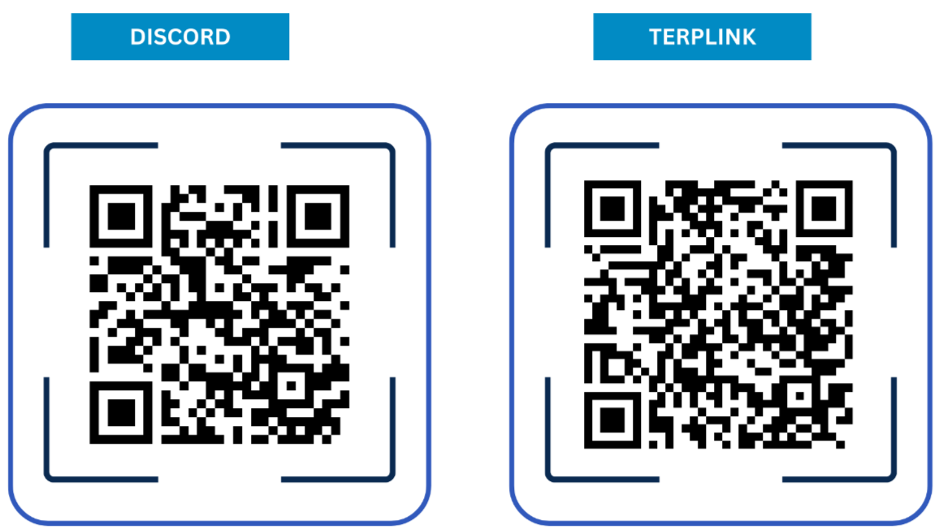
Join BigThinkAI!

Slide 11
Now on to the fun part!
https://tinyurl.com/bigthink2025

